Slide 1
Pattern Recognition

Slide 2
Text Books
Pattern Recognition
  S. Theodoridis & K. Koutrumbas
Pattern Classification
  R. Duda et al.
Pattern Recognition Statistical, Structural and Neural Approaches
  R. Shalkoff

Slide 3
Pattern Recognition: What is it?
The act of taking as input sensed data(measurements)
and taking an action
based on the “category” or “class” ofthe pattern.

Slide 4
What It Does
Build a machine that can recognize patterns:
The task: Assign unknown objects – patterns – into the correct class. This is known as classification.

Slide 5
What It Does
Areas:
  Machine vision
  Character recognition (OCR)
  Computer aided diagnosis
  Speech recognition
  Face recognition
  Bioinformatics
  Image Data Base retrieval
  Data mining
  Biometrics
    Fingerprint identification
    Iris Recognition
  DNA sequence identification

Slide 6
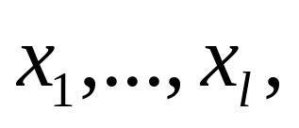
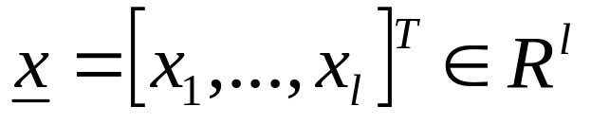
Representation of patterns
Features:
  measurable quantities from the patterns
  determines the classification task
Feature vectors: A number of features
constitute the feature vector
Feature vectors are treated as random vectors.

Slide 7
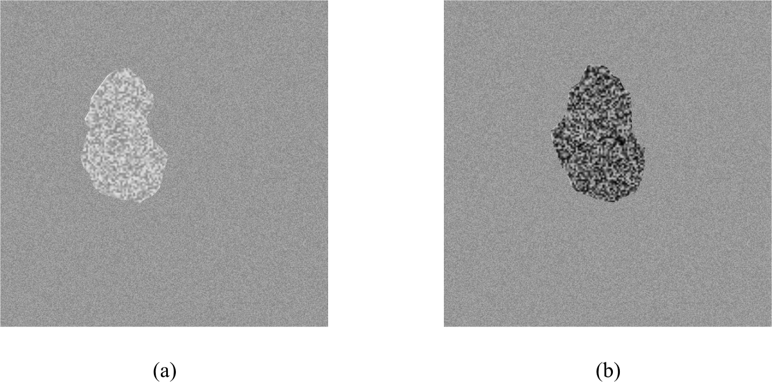
Example 1:

Slide 8
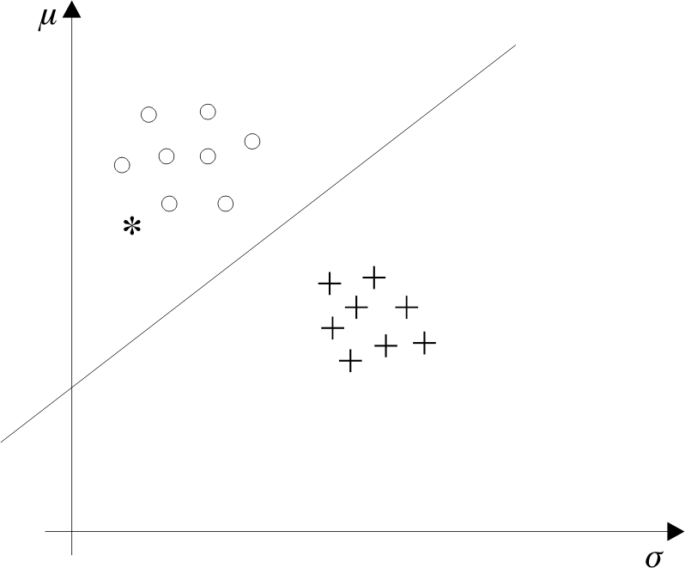
Example 1:

Slide 9
Issues in Pattern Recognition
How are features generated?
What is the best number of features?
How are they used to design a classifier?
How good is the classifier?

Slide 10
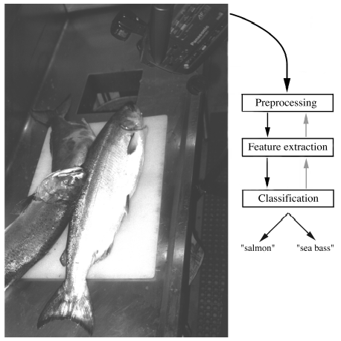
Example 2
“Sorting incoming Fish on a conveyor according to species using optical sensing”
Sea bass
Species
Salmon

Slide 11
Problem Analysis
  Set up a camera and take some sample images to extract features
    Length
    Lightness
    Width
    Number and shape of fins
    Position of the mouth, etc…

Slide 12
Preprocessing
  isolate fishes from one another and from the background
Feature Extraction
  send isolated fish image to feature extractor
  it reduces the data too
Classification
  pass the features to a classifier

Slide 14
Classification
  Select the length of the fish as a possible feature for discrimination

Slide 15
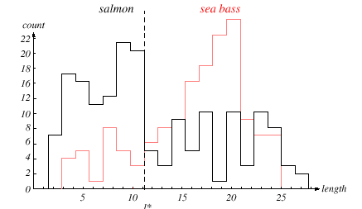
x*

Slide 16
The length is a poor feature alone!
Select the lightness as a possible feature.

Slide 17
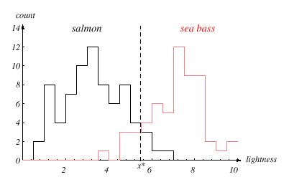

Slide 18
Threshold decision boundary and cost relationship
  Move our decision boundary toward smaller values of lightness in order to minimize the cost (reduce the number of sea bass that are classified as salmon!)
  Task of decision theory

Slide 19
Adopt the lightness and add the width of the fish
Fish x^{T} = [x₁, x₂]
Lightness
Width

Slide 20
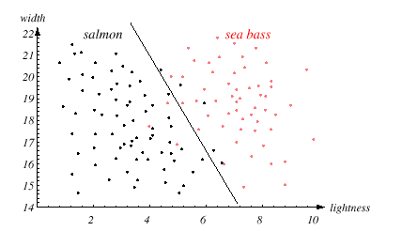

Slide 21
adding correlated feature does not improve anything and is thus redundant
too many features may lead to curse of dimensionality

Slide 22
still there are some misclassifications

Slide 23
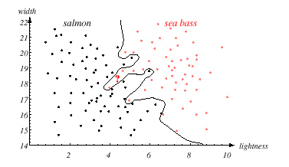
perhaps the best one, but too complex decision boundary

Slide 24
satisfaction is premature
  cause: aim of a classifier is to correctly classify unknown input
Issue of generalization!

Slide 25
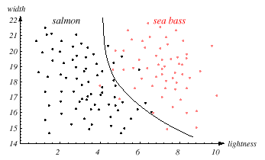
A compromise between training and testing

Slide 26
Pattern Recognition Systems
Sensing
  Use of a transducer (camera or microphone)
  PR system depends of the bandwidth, the resolution sensitivity distortion of the transducer
Segmentation and grouping
  Patterns should be well separated and should not overlap

Slide 27
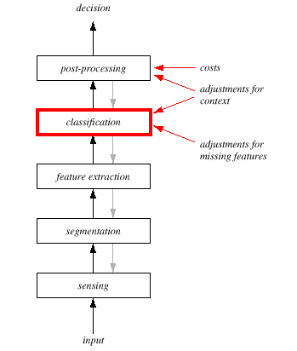

Slide 28
Feature extraction
  Discriminative features
  Invariant features with respect to translation, rotation and scale.
Classification
  Use a feature vector provided by a feature extractor to assign the object to a category
Post Processing
  error rate
  risk
  use context

Slide 29
The Design Cycle
Data collection
Feature Choice
Model Choice
Training
Evaluation
Computational Complexity

Slide 30
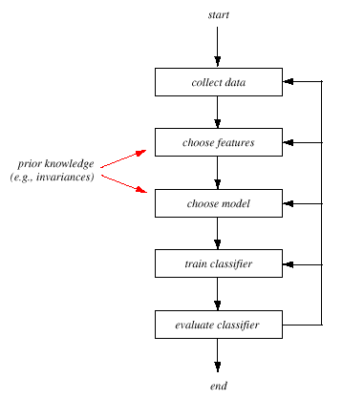

Slide 31
Data Collection
  How do we know when we have collected an adequately large and representative set of examples for training and testing the system?

Slide 32
Feature Choice
  Depends on the characteristics of the problem domain.
  Requirement
    simple to extract
    invariant to irrelevant transformation
    insensitive to noise.

Slide 33
Model Choice
  too many classification models?
  which one is best?

Slide 34
Training
  Use data to determine the classifier. Many different procedures for training classifiers and choosing models

Slide 35
Evaluation
  Measure the error rate (or performance and switch from one set of features to another one

Slide 36
Computational Complexity
  What is the trade-off between computational ease and performance?

Slide 37
Learning and Adaptation
Supervised learning
  A teacher provides a category label or cost for each pattern in the training set
Unsupervised learning
  The system forms clusters or “natural groupings” of the input patterns

Slide 38
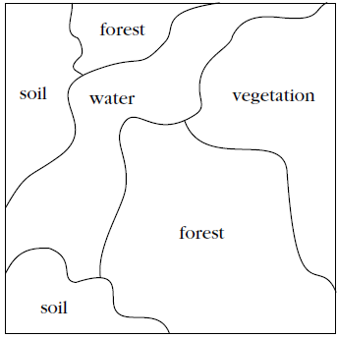
Unsupervised Learning

Slide 39
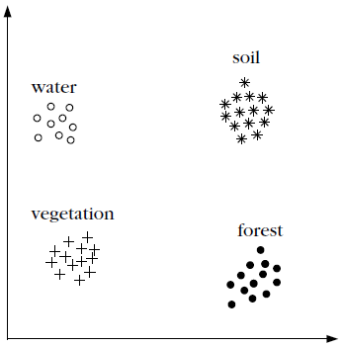
Unsupervised Learning
x₁
x₂

Slide 40
Unsupervised Learning
x₁
x₂

Slide 41
Unsupervised Learning
x₁
x₂

